Slide 1
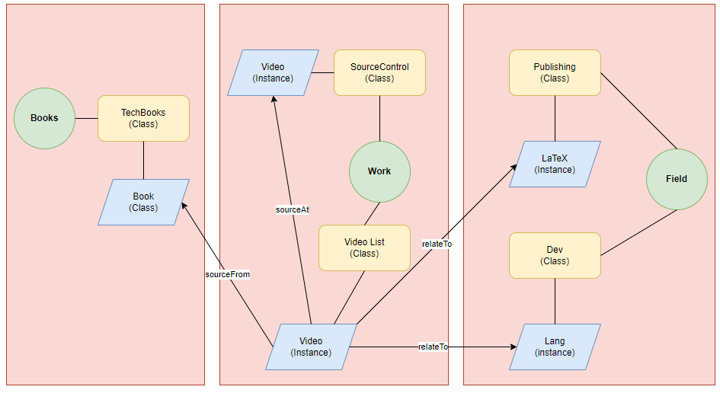
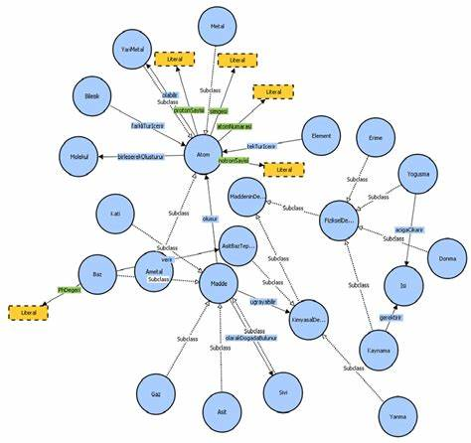


Deal with Multi-Ontologies

Slide 2

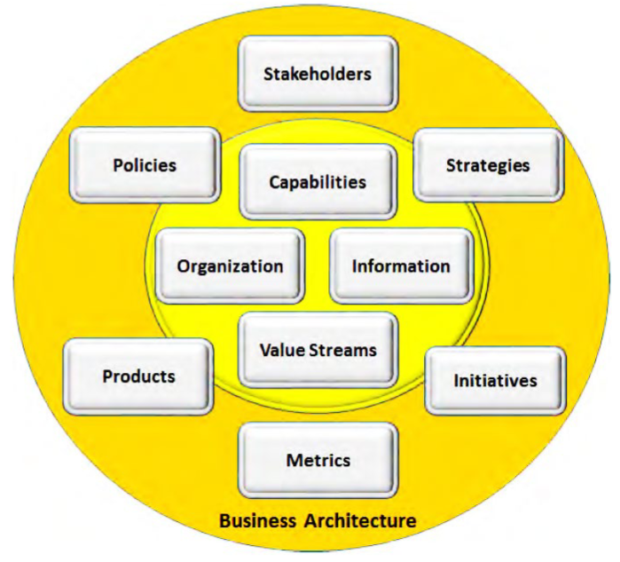
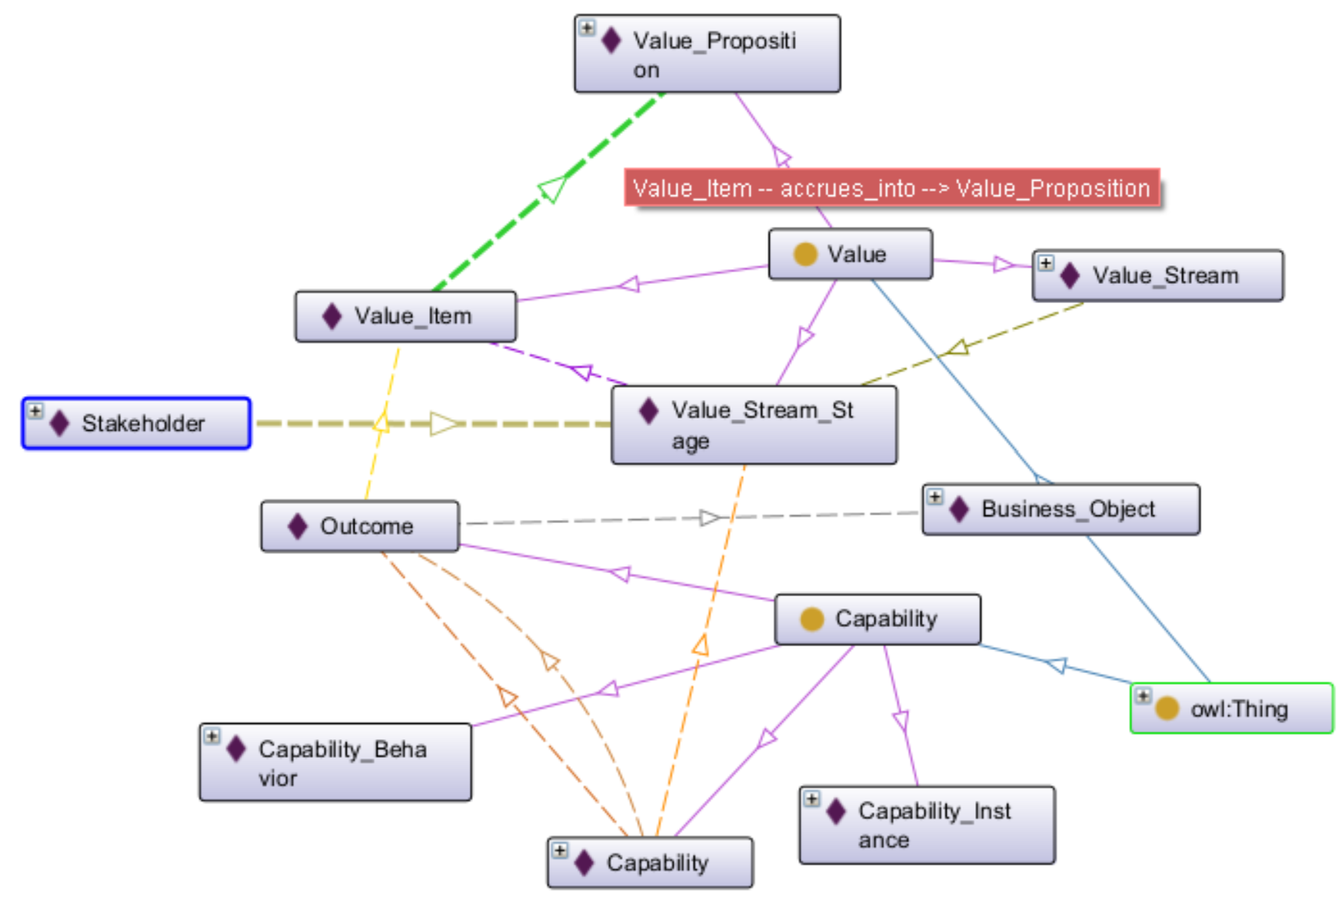


Ontology View of Business Architecture Meta-Model

Slide 3
Ontology View of Business Architecture Meta-Model
Introduce Meta-Model Structure in Biz Architecture
Translate & Build Class / Individual Structure in Protege
Connect Relationships as Object Properties
Visualize Ontology and Practice Query

